Slide 1
Evaluating Hypotheses

Slide 2
Ex | citations | size | inLibrary | price | editions | buy
1 | many | big | always | expensive | one | no
2 | some | small | always | affordable | many | yes
3 | many | small | no | affordable | few | no
4 | some | medium | always | affordable | one | yes
5 | some | big | always | expensive | one | yes
h= (some, ?, always, ?, ?)

Slide 3
Evaluating Hypotheses
It is important to evaluate the performance of learned hypotheses
One reason is simply to understand whether to use the hypothesis
Evaluating hypotheses is an integral component of many learning methods

Slide 4
Evaluating Hypotheses
Estimating the accuracy of a hypothesis is relatively straightforward when data is plentiful.
However, when we must learn a hypothesis and estimate its future accuracy given only a limited set of data.

Slide 5
Two key difficulties arise in the accuracy estimation
Bias in the estimate
Variance in the estimate

Slide 6
Two key difficulties arise in the accuracy estimation
Bias in the estimate
The observed accuracy of the learned hypothesis over the training examples is often poor estimator of its accuracy over future examples. Because the learned hypothesis was derived from these examples, they will typically provide an optimistically biased estimate of hypothesis accuracy over future examples
To obtain an unbiased estimate of future accuracy, we typically test the hypothesis on some set of test examples chosen independently of the training examples and the hypothesis

Slide 7
Two key difficulties arise in the accuracy estimation
Variance in the estimate
Even if the hypothesis accuracy is measured over an unbiased set of test examples independent of the learning examples, the measured accuracy can still vary from the true accuracy, depending on the makeup of the particular set of test examples.
The smaller the set of test examples, the greater the expected variance

Slide 8
Estimating Hypothesis Accuracy
Given a hypothesis h and a data sample containing n example drawn at random according to the distribution D,
What is the best estimate of the accuracy of h over future instances drawn from the same distribution?
What is the probable error in this accuracy estimate?

Slide 9
Two definition of Error Sample Error
The sample error of h with respect to target function f and data sample S is the proportion of examples h misclassifies
The sample error (denoted error_{s}(h)) of hypothesis h with respect to target function f and data sample s is

Slide 10
Two definition of Error Ture Error
The true error of a hypothesis is the probability that it will misclassify a single randomly drawn instance from the distribution D
The true error (denoted error_{D}(h)) of hypothesis h with respect to target function f and distribution D, is the probability that h will misclassify an instance drawn at randomly according to D

Slide 11
We wish to know is the true error (error_{D}(h)) of the hypothesis, because this is the error we can expect when applying the hypothesis to future examples.
All we can measure is the sample error (error_{s}(h)) of the hypothesis for the data sample S that we happen to have in hand
“How Good an estimate of error_{D}(h) is provided by error_{s}(h)?”

Slide 12
Confidence Intervals for Discrete – Valued Hypotheses
To estimate the true error for some discrete value hypothesis h, based on its observed sample error over a sample S,
Where,
The sample S contains n examples drawn independent of one another, and independent of h, according to the probability distribution D
n>=30
Hypothesis h commits r errors over these n examples (error_{s}(h) =r/n)

Slide 13
Confidence Intervals for Discrete – Valued Hypotheses
Hypothesis h misclassifies 12 of 40 examples in S.
What is error_{D}(h)?

Slide 14

Under these conditions, statistical theory allows us to make the following assertions
Give no other information, the most probable value of error_{D}(h) is errors(h)
With approximately 95% probability, the true error_{D}(h) lies in the interval
The general expression for approximate N% confidence intervals for errorD(h) is

Slide 15
Example
Hypothesis h misclassifies 12 of the 40 examples in S
What is error_{D}(h)?
Given no other information, our best estimate is 0.30
With approximately 95% probability, error_{D}(h) lies in the interval
0.3
0.14

Slide 16
error_{S}(h) is a Random Variable
Rerun experiment with different randomly drawn S (size n)
Probability of observing r misclassified examples:

Slide 17
Binomial Distribution
Binomial distribution determines the probability of observing a specific number of successful outcomes in a specified number of trials

Slide 18
Binomial Probability Distribution
n is the number of trials (occurrences)
r is the number of successful trials
p is the probability of success in a single trial
^{n} C _{x} is the combination of n and x.

Slide 19
Binomial Probability Distribution

Slide 20
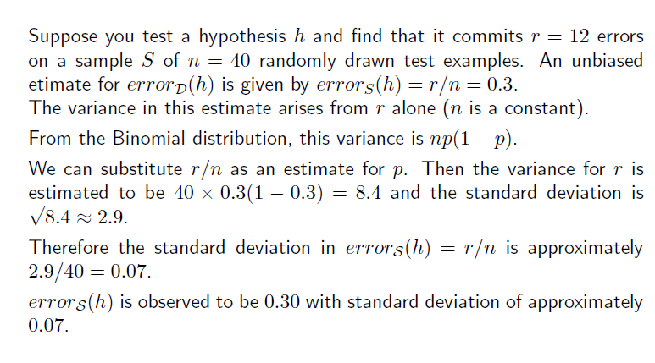
Example

Slide 21
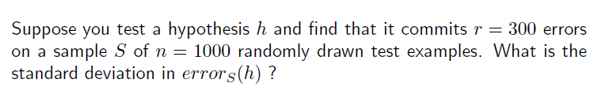

Slide 22
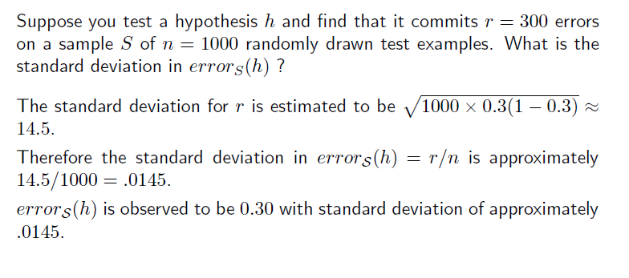
Example

Slide 23
Normal Probability Distribution

Slide 24
Normal Probability Distribution

Slide 25
Central Limit Theorem

Slide 26
Difference in error of two Hypotheses

Slide 27
Comparing Learning Algorithms
L_{A} and L_{B} are two learning Algorithms
To determine which of L_{A} and L_{B} is the better learning method on average for learning some particular target function f
To estimate the expected value of the difference in their errors
where L(S) is the hypothesis output by learner L using training set S
the expected difference in true error between hypotheses output by learners L_{A} and L_{B}, when trained using randomly selected training sets S drawn according to distribution D.

Slide 28
Comparing Learning Algorithms
But, given limited data D₀, what is a good estimator?
Could partition D₀ into training set S₀ and training set T₀ and measure
Above equation measuring the difference in errors for one training set S₀
One way to improve on estimator is to repeatedly partition the data D₀ into disjoint training and test sets

Slide 29
Comparing Learning Algorithms L_{A} and L_{B}

Slide 30
Paired t test to Compare h_{A},h_{B}

